Slide 1
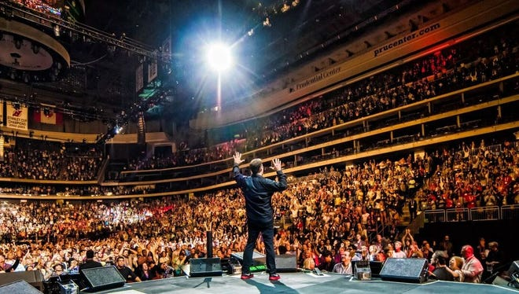
High ticket coaching & information products case study by feras elghandour

Slide 3
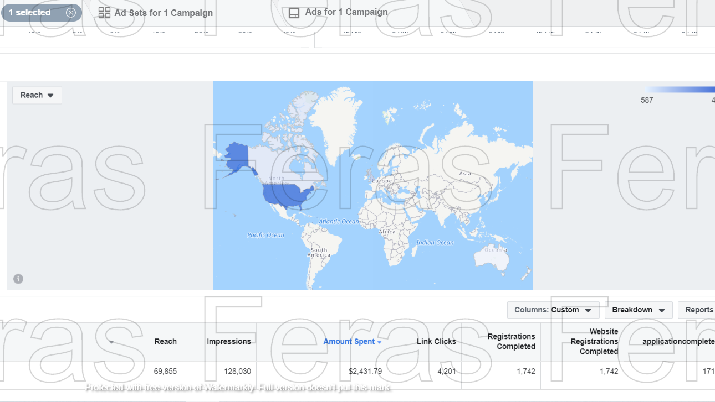

Slide 5
Thank You

